Slide 1
Vasilis Tsavalias

Slide 2
PREGSAFE: Enhancing GDM Management Using Synthetic Data
Team Members
Institutions
Dr. Ioannis Tsakiridis (AUTH) - Project Coordinator
Dr. Themistoklis Dagklis (AUTH) - Medical Doctor
Dr. Apostolos Mamopoulos (AUTH) - Medical Doctor
Dr. Christina Volioti (AUTH) - AI & ML expert
Dr. Mittas Nikolaos (DUTH) - AI & ML expert
Trygoniaris Dimitrios (DUTH) - AI & ML expert
Dr. George Kyzas (DUTH) - Technical Manager
Dr. Apostolos Ampatzoglou (DUTH) - Software Researcher
Vasilis Tsavalias (DUTH) – MLOps developer
Democritus University of Thrace (DUTH)
Aristotle University of Thessaloniki (AUTH)
Healthcare Professionals & Clinical Experts

Slide 3
PART 0: Introduction
GDM & the importance of synthetic data

Slide 4
Why is GDM a global threat?
Gestational Diabetes Mellitus (GDM) is rapidly becoming a critical global health challenge.
Its increasing prevalence, driven by evolving lifestyles and demographic shifts, poses substantial risks to maternal and child health worldwide.
Beyond immediate health complications, GDM carries a significant economic burden on healthcare systems globally.
Economic Burden
In China, for example, the annual societal economic burden of GDM is estimated to be ¥19.36 billion ($5.59 billion USD)
7-9%
Increasing Risk Factors
Global prevalence that is depended on the data source used (e.g. Australia 16%)
driven by increasing obesity rates and advanced maternal age
Source: https://www.researchgate.net/publication/362564025_A_scoping_review_of_gestational_diabetes_mellitus_healthcare_experiences_of_care_reported_by_pregnant_women_internationally/citations

Slide 5
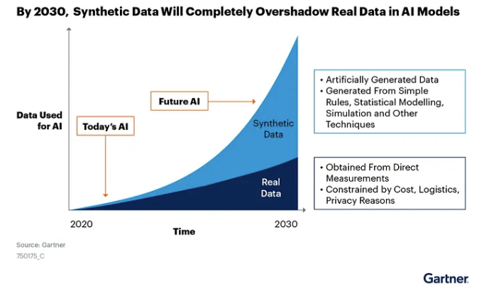
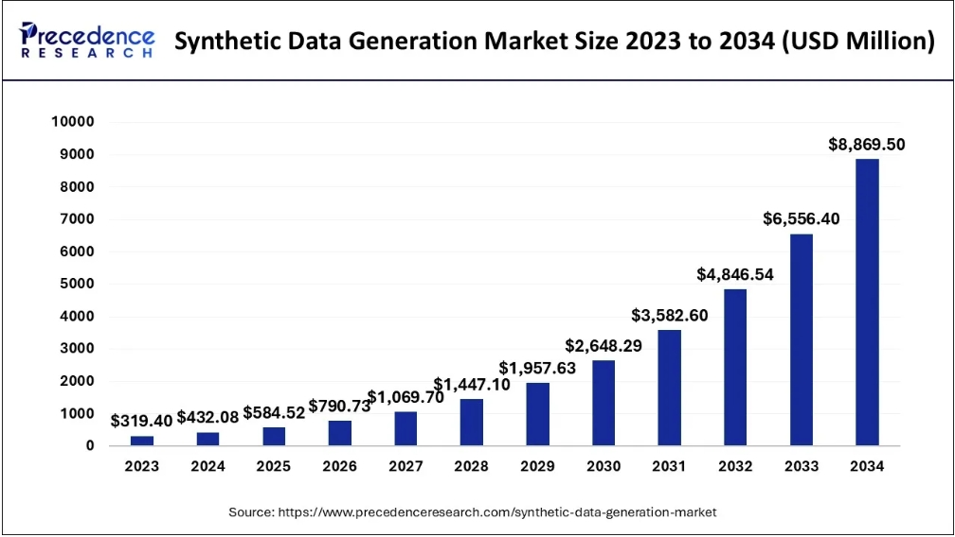
Are Synthetic Data the future of AI?
Source: https://www.precedenceresearch.com/synthetic-data-generation-market
Source: https://systemweakness.com/the-rise-of-synthetic-data-replacing-real-world-data-for-better-ai-dae05ccacfde

Slide 6
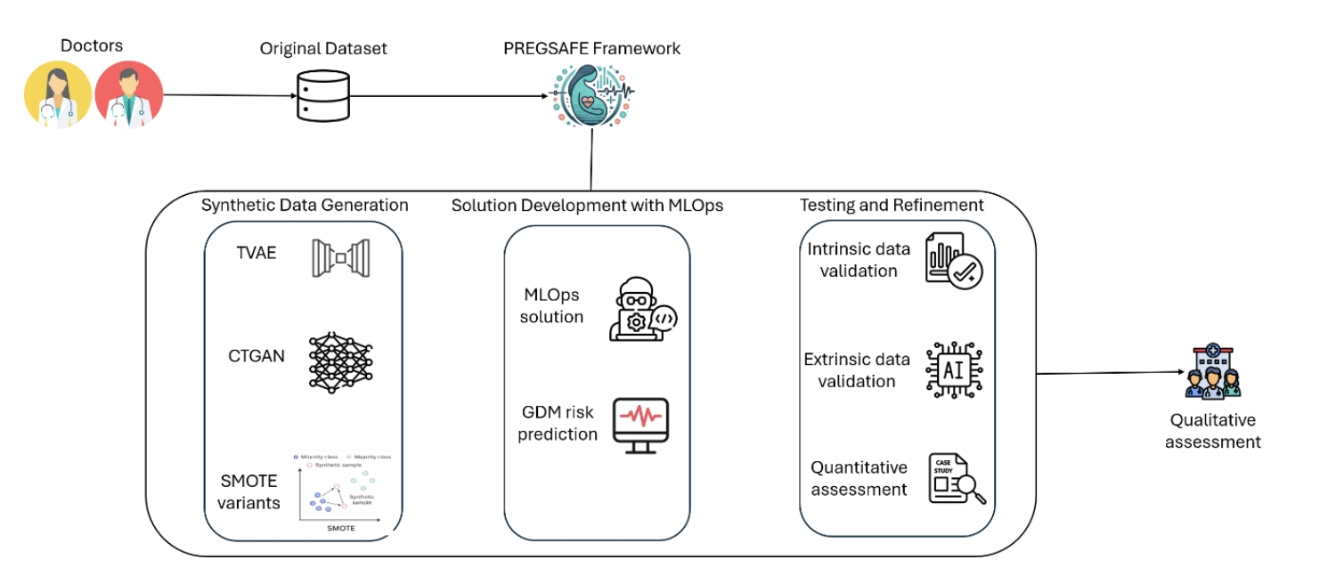
How does the PREGSAFE Framework work?

Slide 7
PART 1: Data Preparation
Feature Selection & Cross-Validation Setup

Slide 8
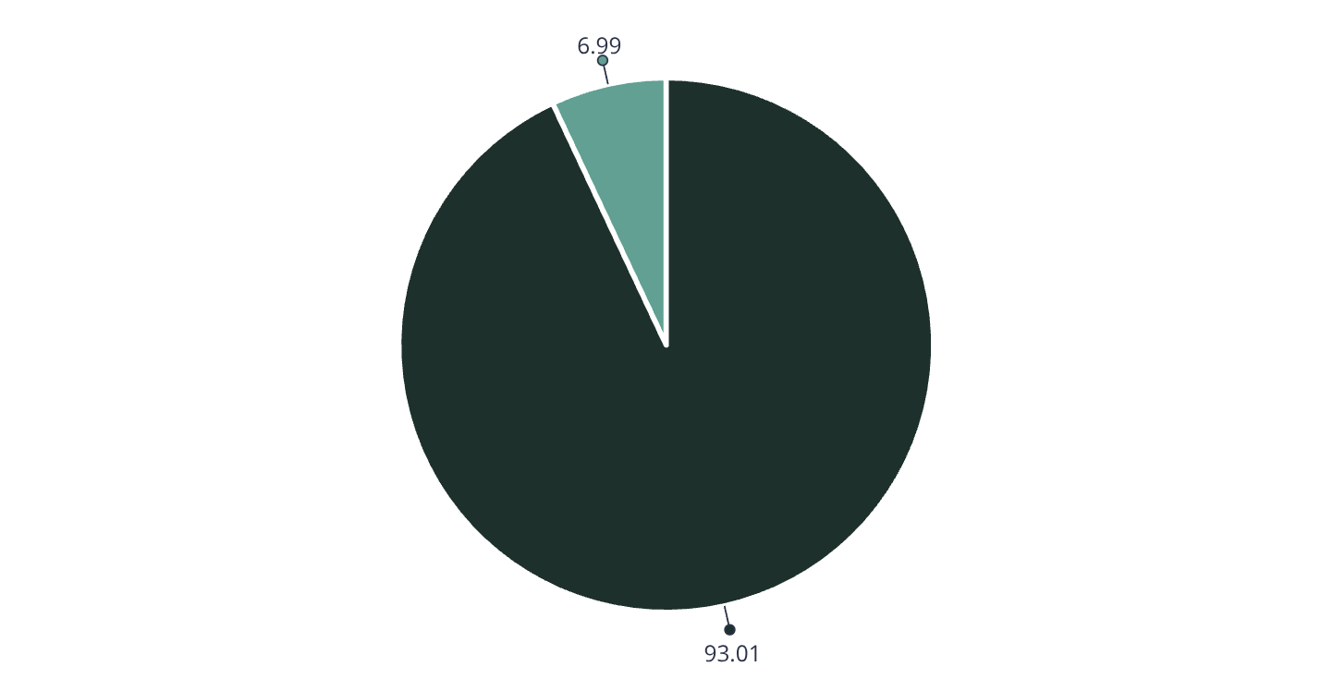
What is the 'Villain' of this story?
Source: 3rd Department of Obstetrics and Gynecology, Aristotle University of Thessaloniki, Greece
Study Participants: 6,046 Pregnant women from Aristotle University of Thessaloniki
Key risk factors: maternal age >35 (40.9% in GDM group vs
26.0% in non-GDM group), Body Mass Index (BMI), and history of thyroid conditions.
Eligibility Criteria: Age >18 years, absence of serious medical conditions,
absence of pre-existing diabetes (Type 1 or Type 2),
and known weight and height measurements.
=>This imbalance poses a significant challenge for standard machine learning models,often leading to high overall accuracy but poor sensitivity for the minority class, necessitating advanced techniques like Synthetic Data Generation (SDG).
Non-GDM (93.01%)
GDM (6.99%)

Slide 9
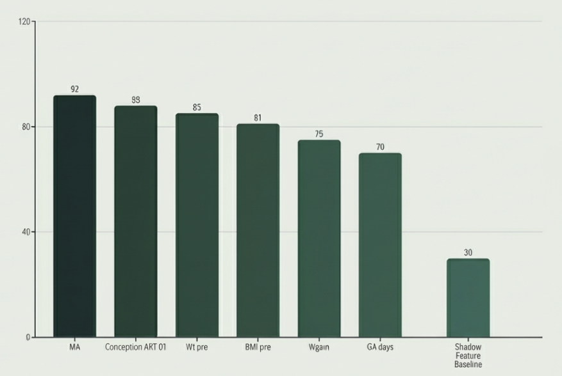
How do we separate Signal from Noise?
Algorithm: Boruta
(Random Forest Wrapper)
Mechanism: "Shadow Features"
(Permuted Noise Tournament)
Threshold: P-value = 0.05, 500 Iterations
Selected Predictors (6):
Maternal Age
Conception with methods of assisted
reproductive technologies
baseline weight before pregnancy
BMI before pregnancy
Weight gain after pregnancy
Gestational days.

Slide 10
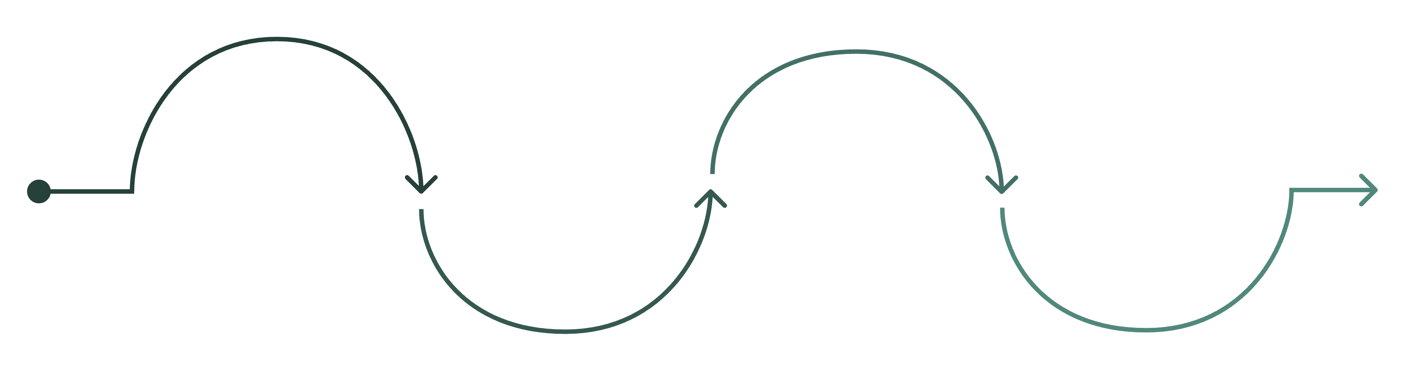
How do we ensure statistical robustness?
Methodology: Stratified 10-fold cross-validation
Purpose: Robust performance estimation with class balance preservation
Implementation: Each fold maintains original 7% GDM prevalence
Benefit: Reduces overfitting and provides reliable performance metrics
Statistical Power: 10 independent train/test splits for robust evaluation
Aggregate
Fold 1
Split Data
Iterate Folds
Combine performance metrics across folds
Use fold 1 as test, remaining nine train
Divide dataset into 10 stratified folds
Repeat for folds 2 through 10 as test

Slide 11
PART 2: Synthetic Data Generation
Theory, Implementation & Results

Slide 12
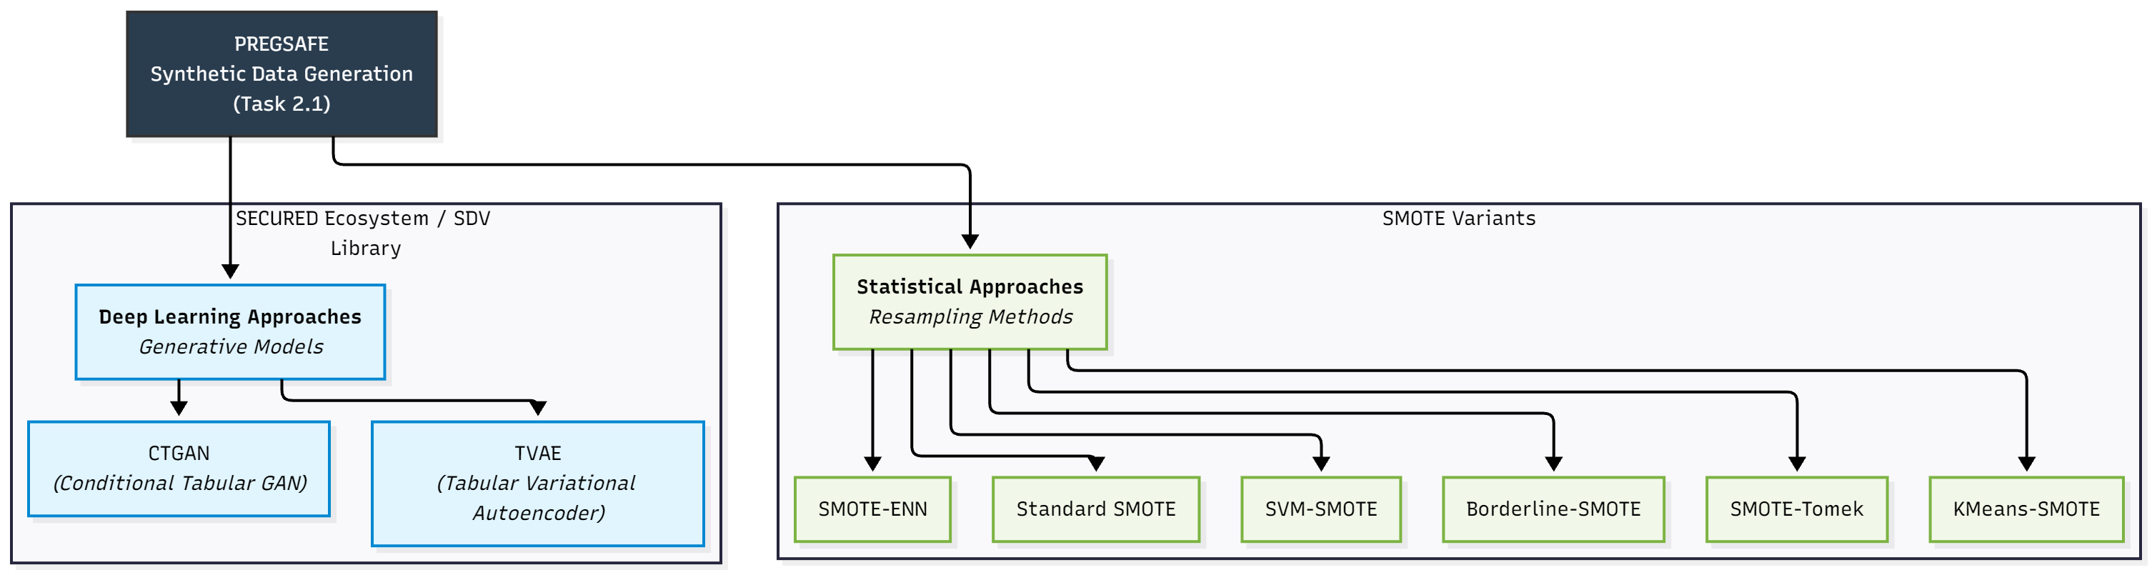
The PREGSAFE Toolkit: A deep dive
Objective: Identify the optimal Synthetic Data Generation (SDG) technique
Branch A (Statistical): SMOTE,
Borderline-SMOTE, SVM-SMOTE
Branch B (Deep Learning): TVAE (Variational Autoencoder),
CTGAN (Adversarial Network)

Slide 13
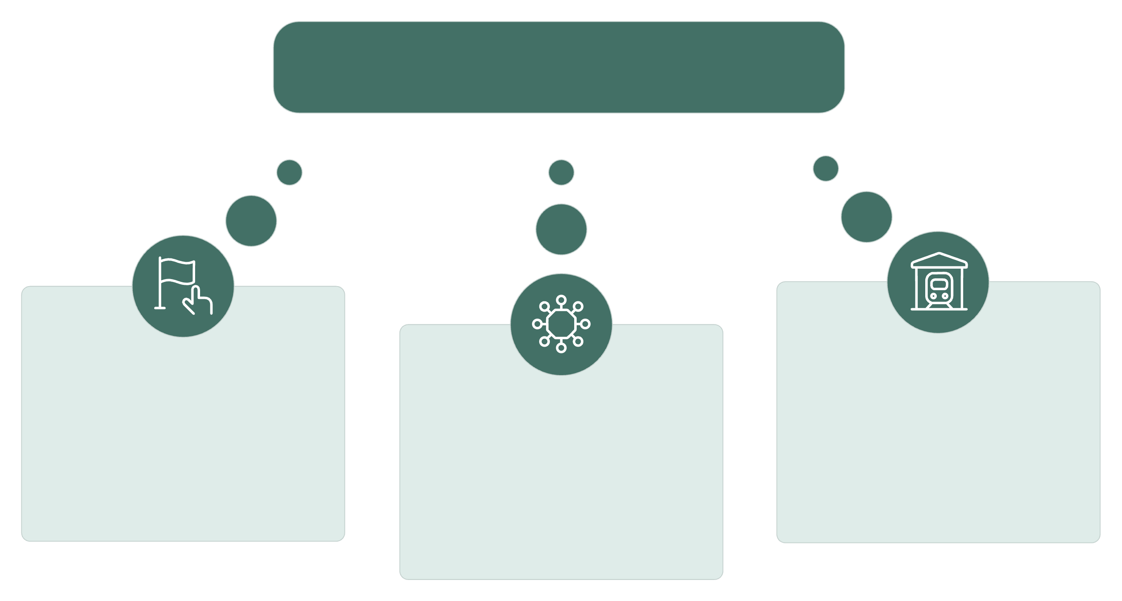
Understanding SMOTE – How does it work?(1/2)
Synthetic Minority Oversampling Technique (SMOTE)
is a statistical method for addressing class imbalance. It works by generating
synthetic samples in feature space
Formula: New_sample = Original + random(0,1) × (Neighbor - Original)
It Guarantees synthetic samples lie within minority class boundaries,
Expanding and smoothing boundaries for better classification
SMOTE
Minority Points
Augmented Set
Find Neighbors
Original minority class instances in the dataset. These are the rare cases we need to augment.
Generate synthetic
samples along
The lines between
points and neighbors.
Identify k-nearest minority
neighbors for each point.
Typically k=5 neighbors
are used for interpolation.

Slide 14
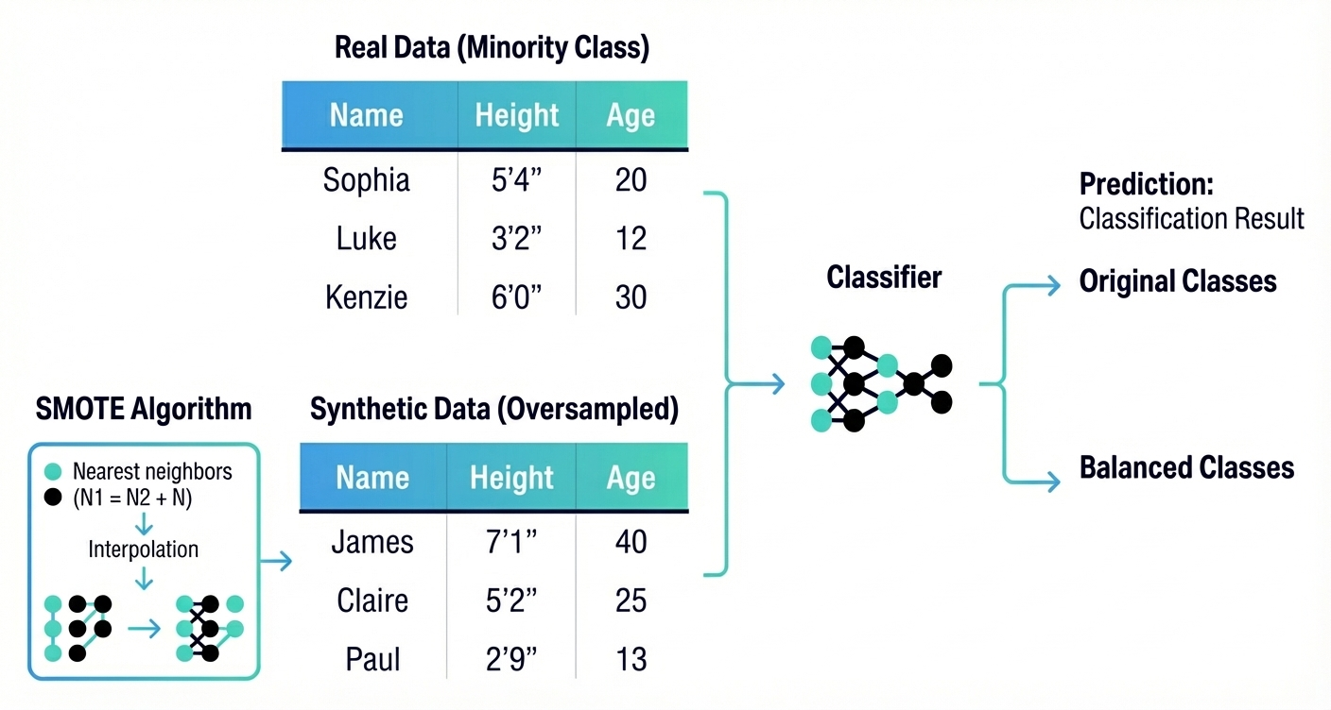
Understanding SMOTE – How does it work?(2/2)
The neighbor search identifies a real data
point from the minority class and finds its
most similar existing matches (k-nearest
neighbors) within the dataset.
The interpolation step
generates synthetic data by mathematically
selecting a new point along the line
Connecting these real examples.
Source: Generated by Gemini 3.0 pro preview nano banana

Slide 15




Understanding TVAE– is it viable? (1/2)
TVAE is a deep learning approach adapted for tabular data Based on Variational Autoencoder (VAE) architecture.
It utilizes Two main components: Encoder and Decoder.
Optimizes Evidence Lower Bound (ELBO) objective function Handles mixed data types
(continuous and categorical variables)
Uses mode-specific normalization for different column types
Challenge: Struggles with conditional sampling for rare classes
Input Data
Encoder
Latent Space
Raw tabular features and columns enter the model.
Maps the input data to parameters of a latent distribution. (great for privacy)
A probabilistic bottleneck representing compressed features (mean, log-variance).
Decoder
Reconstructed Data
Samples from the latent space to reconstruct the original data.
The output, aiming to match the initial input for training the VAE.

Slide 16
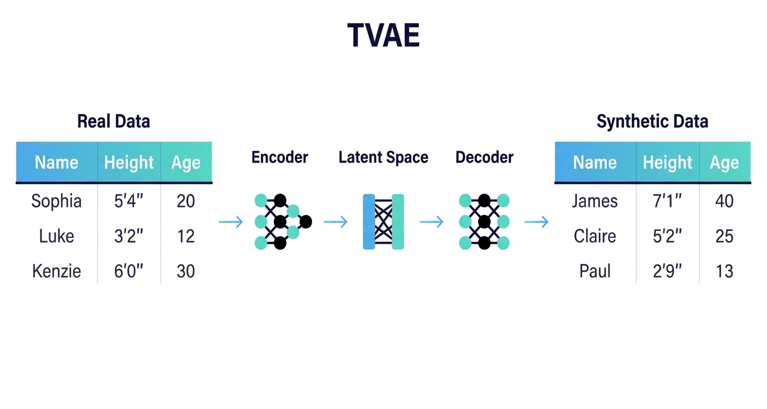
Understanding TVAE– is it viable? (2/2)
The encoder is a neural network that
compresses the real data into a compact
statistical summary (latent space).
The decoder is a neural network that
reconstructs this summary to create
synthetic data.
Source: Generated by Gemini 3.0 pro preview nano banana

Slide 17
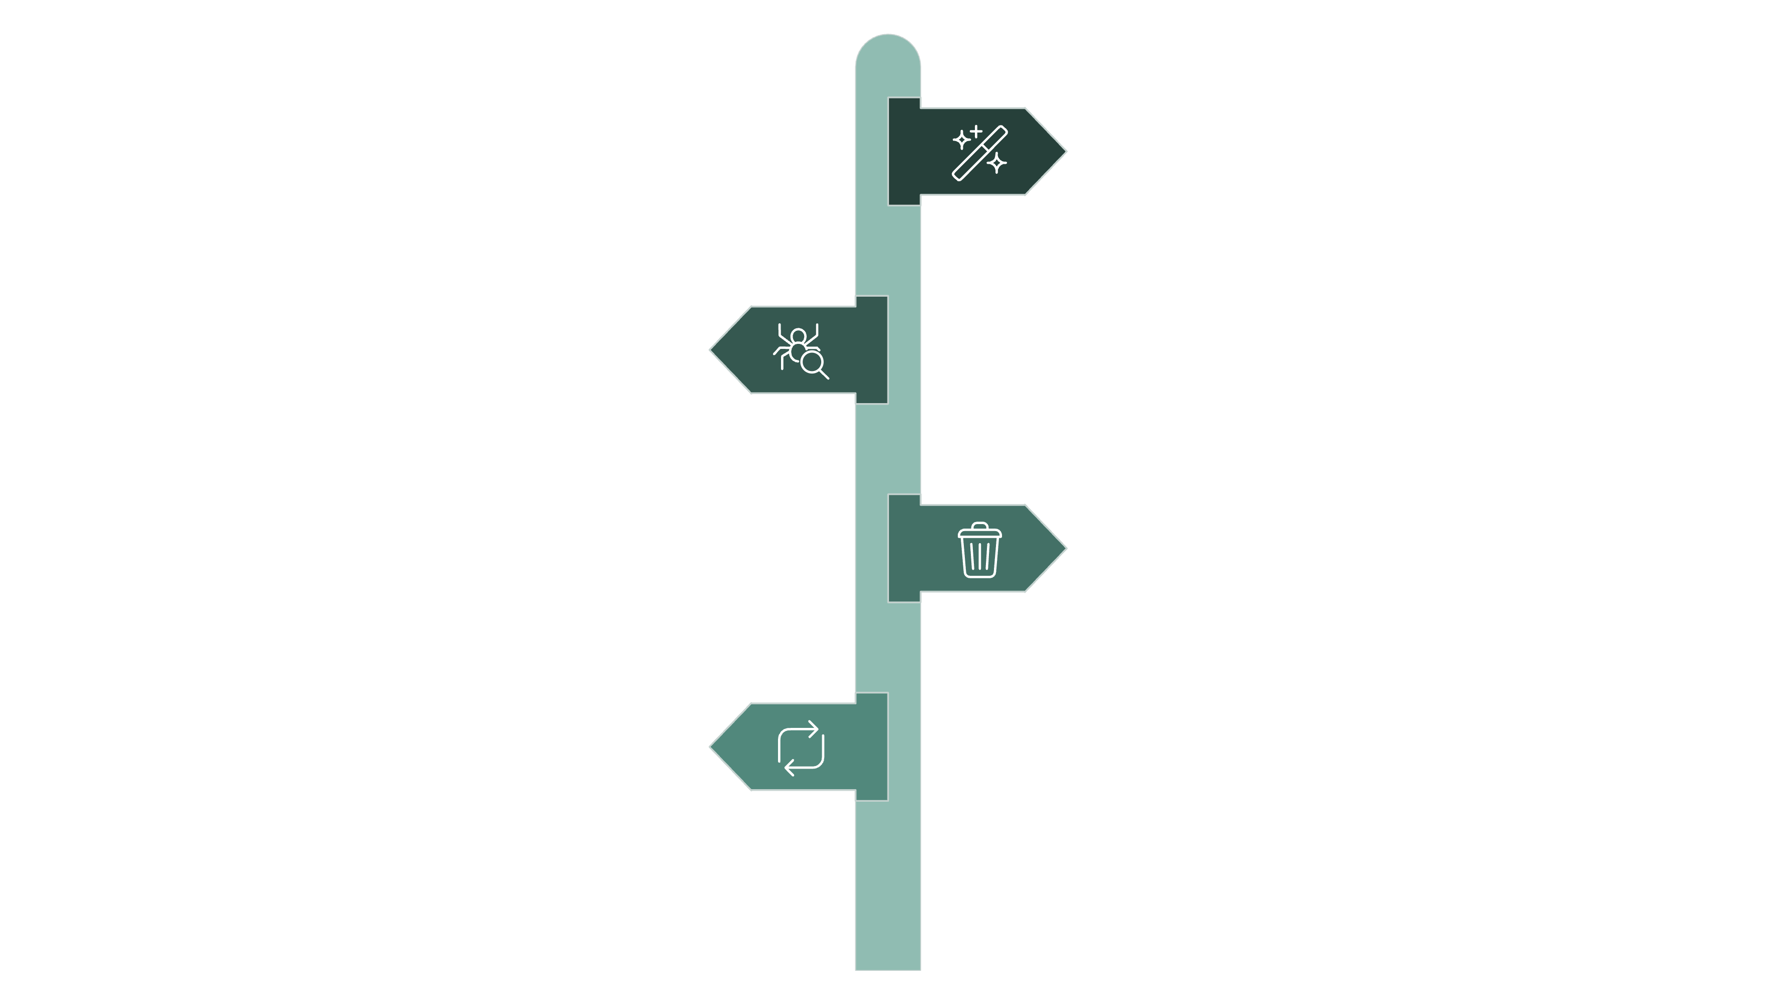
The Deep Learning Paradox (TVAE)
TVAE cannot handle extreme class imbalance because it relies on rejection sampling instead of true conditional generation.
The model does not take a conditional vector for target labels; it samples unconditionally from the latent space.
To stress-test this, the max_tries_per_batch parameter was increased from 100 to 50,000, letting the model resample an extreme number of times. With a minority class at ~7%, the probability of randomly producing a positive GDM case is effectively near-zero.
Rejection sampling becomes computationally impossible for rare-event generation, unlike models with native conditional support (CTGAN )
Generate Sample
Randomly produce a synthetic data point.
Check Minority?
Evaluate whether the sample belongs to the minority class.
Discard If Not
Reject and drop samples that are not minority class.
Repeat Loop
Continue sampling until a minority sample is obtained.

Slide 18
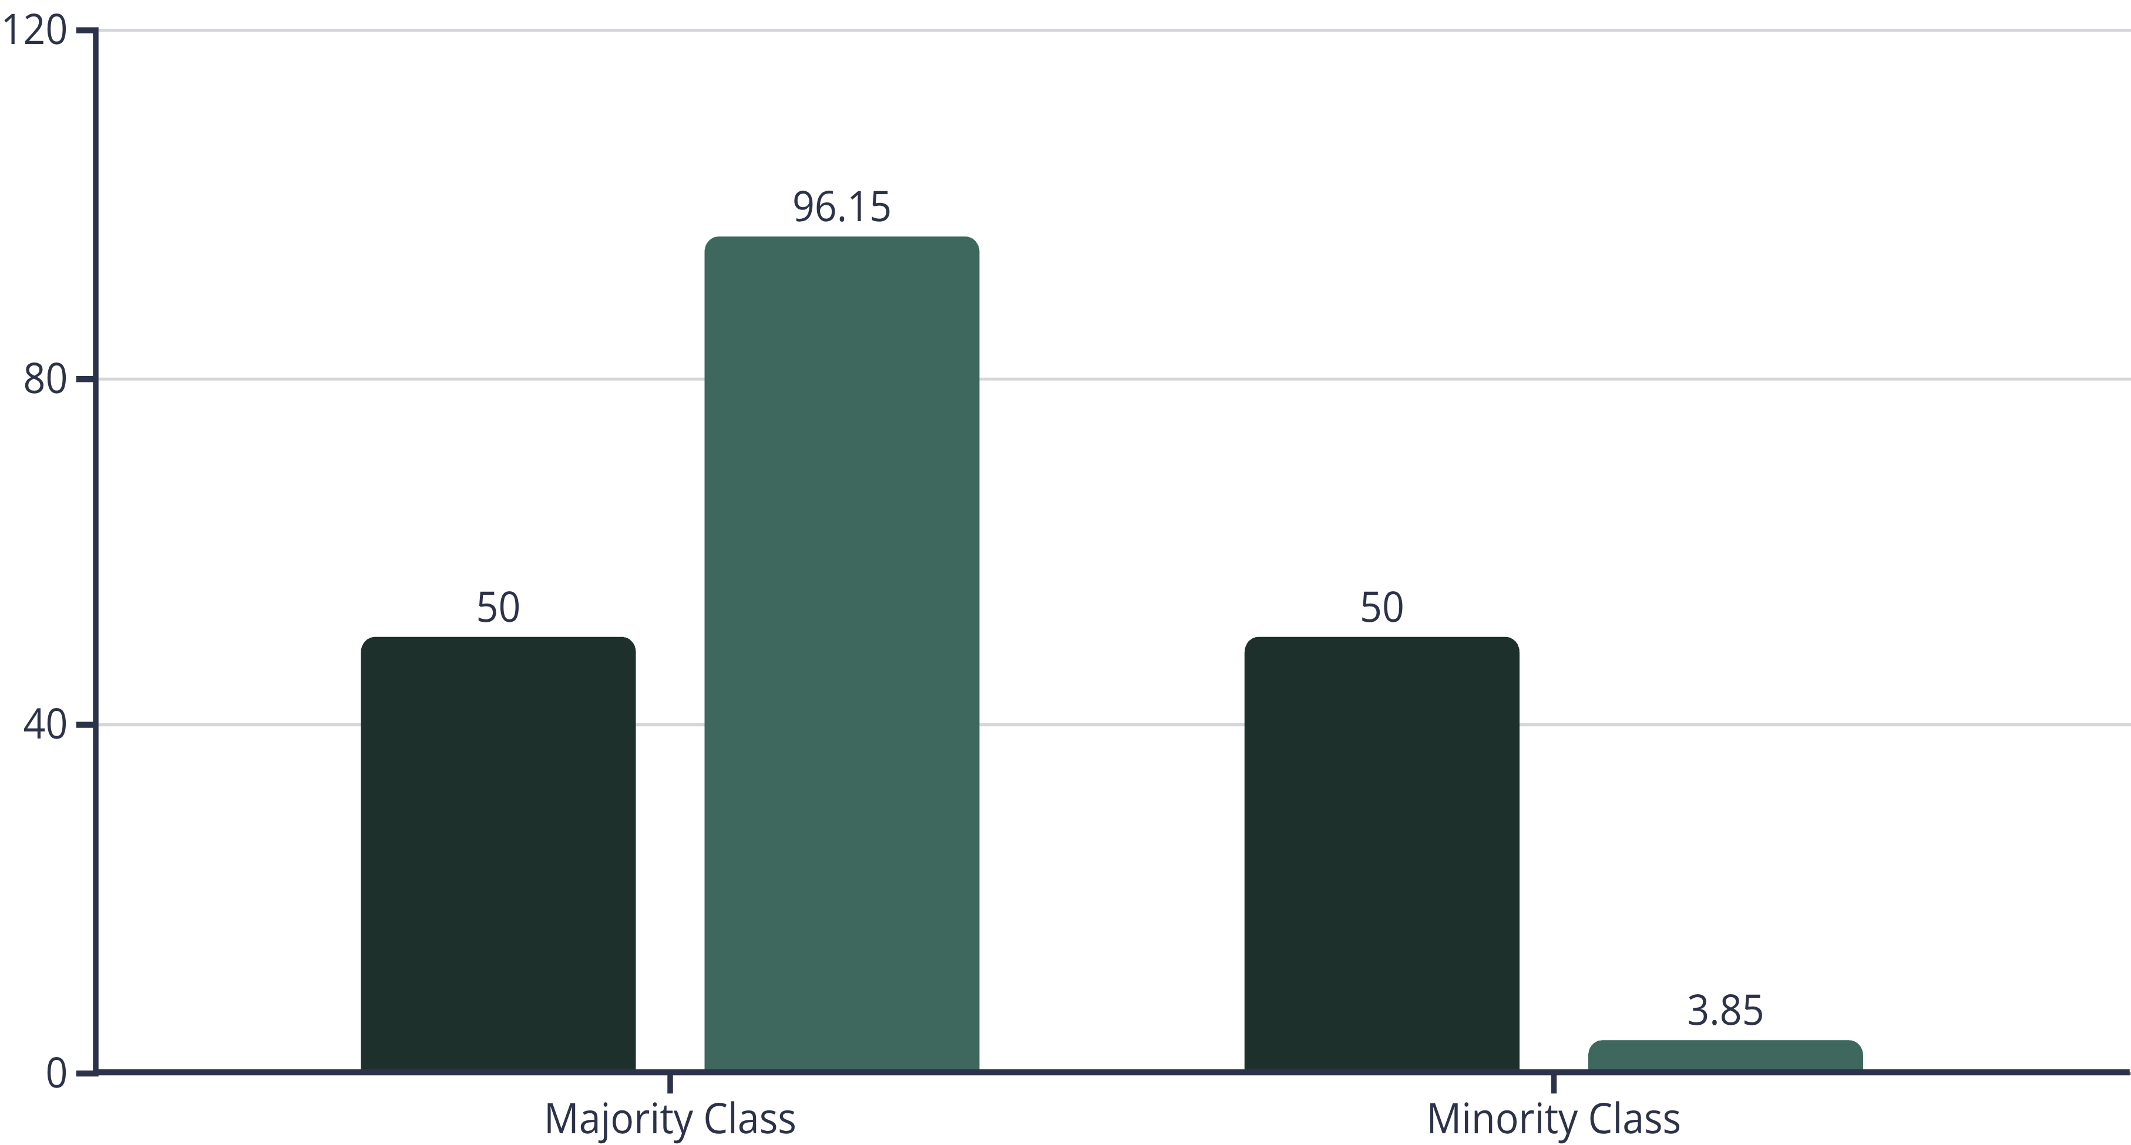


Did TVAE survive?
Outcome: Mode Collapse & Catastrophic Failure in Conditional Sampling Majority Class Output: 96.15%
Minority Class Output: 3.85% (Worsened imbalance from original 7%)
Conclusion: Standard VAEs failed to generate *any* successful minority class samples over 3 days,
rendering them ineffective for low-prevalence minority classes.
Target Distribution (%)
TVAE output (%)

Slide 19





Can CTGAN fix the problem? (1/2)
CTGAN is a deep learning approach using adversarial training Two competing networks: Generator and Discriminator.
Key Innovation: Conditional vectors for targeted generation.
Training uses log-frequency sampling for minority classes.
"Megaphone effect“ => amplifies underrepresented classes.
Excels at conditional sampling for imbalanced datasets.
Input to Generator
Synthetic Data Generation
Discriminator Input
The Generator receives both random noise for variability and conditional vectors to guide the desired data characteristics.
Based on its inputs, the Generator produces synthetic tabular data samples.
The Discriminator is fed a mix of real data from the original dataset and the synthetic data generated by the Generator.
Real/Fake Classification
Adversarial Training
The Discriminator's role is to classify whether each input data sample is real or fake (synthetic).
The Generator and Discriminator continuously train in an adversarial manner, improving their ability to generate realistic data and detect fakes, respectively.

Slide 20
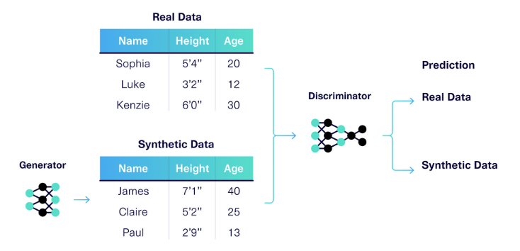
Can CTGAN fix the problem? (2/2)
The generator is a neural network that
creates synthetic data. In this case, it
creates a table describing the names
of different people, along with their
heights and ages.
The discriminator is an
adversarial network that tries to tell these
synthetic people apart from the real ones.
Source: https://sdv.dev/blog/interpreting-ctgan-progress/

Slide 21
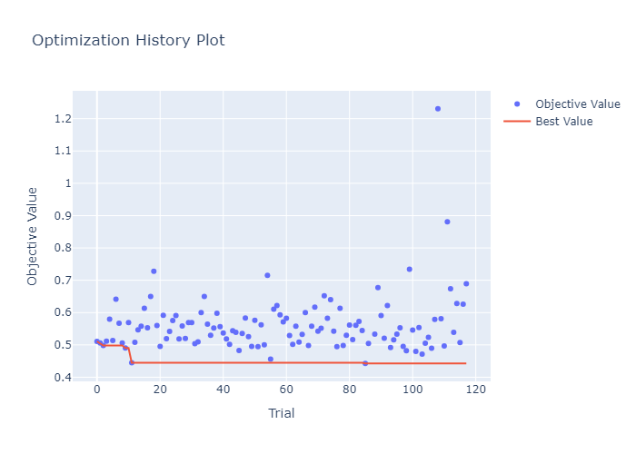
GANs need extensive tuning…right?
The Method: We utilized Optuna, an automated
framework that ran over 100 trials to find the
perfect model configuration.
The Objective: The algorithm tried to
minimize pca_eigen_diff (the difference
in geometric shape between real and fake data).
The Result: The Red Line represents the
"Best Value" .Notice the instability (blue dots
jumping high) GANs are notoriously unstable;
this optimization ensured we picked the specific
configuration (Red Line at ~0.44) that stabilized
training.

Slide 22
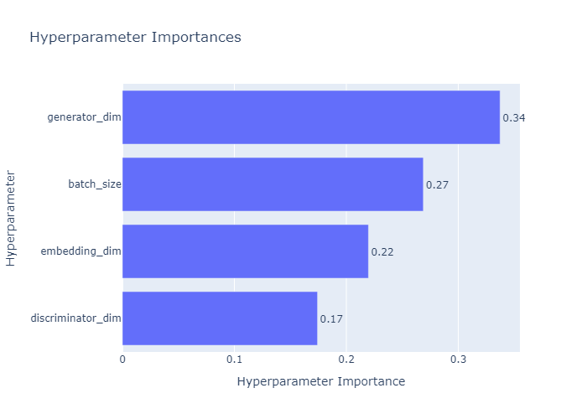
So…what drives performance?
#1 Factor: Generator (34%)
Definition: The size/complexity of the neural network creating the fake patients.
2# Factor: Batch Size(27%)
How many patients the model studies at once before updating its logic.
#3 Factor: Embedding Dimension (22%)
How categorical data (like "Smoker: Yes/No") is converted into numbers. Higher dimension means a more detailed numerical representation.
#4 Factor: Discriminator (17%)
Tuning the Generator's complexity was more critical than tuning the Discriminator.

Slide 23
Did it work?
Achieved perfect 50/50 class balance across all 10 folds
Dataset | Count_Class_0 | Count_Class_1 | Percentage_Class_0 | Percentage_Class_1 | Total_Samples
Train_set_4 | 5057 | 5057 | 50 | 50 | 10114
Train_set_6 | 5062 | 5062 | 50 | 50 | 10124
Train_set_2 | 5053 | 5053 | 50 | 50 | 10106
Train_set_10 | 5053 | 5053 | 50 | 50 | 10106
Train_set_9 | 5050 | 5050 | 50 | 50 | 10100
Train_set_8 | 5061 | 5061 | 50 | 50 | 10122
Train_set_7 | 5058 | 5058 | 50 | 50 | 10116
Train_set_3 | 5057 | 5057 | 50 | 50 | 10114
Train_set_1 | 5057 | 5057 | 50 | 50 | 10114
Train_set_5 | 5054 | 5054 | 50 | 50 | 10108
The CTGAN solution was successfully operationalized from the SECURED toolkit and became the definitive generative
tool for the project's predictive modeling, demonstrating high statistical fidelity and ensuring balanced training sets.

Slide 24
A quick recap!
SDV(CTGAN, TVAE)
Smote - family
Approach
Feature space interpolation
Neural network-based generation
Complexity
Low computational requirements
High computational requirements
Interpretability
High - clear mathematical operations
Low - black box models
Data Types
Works well with numerical features
Handles mixed data types well
Class Balance
Effective for moderate imbalance
CTGAN excels, TVAE struggles with severe imbalance
Training Time
Fast
Slow, requires hyperparameter tuning

Slide 25







Google Cloud Computing (GCP) Infrastructure
Platform
Instance Type
This infrastructure was critical for handling
the computational demands of synthetic
data generation and deep learning
model training ,especially when utilizing the Optuna framework(Search Space Exploration)
GCP resources offered parallel optimization
across multiple configurations
GCP resources were provided by the
National Infrastructures for Research and
Technology GRNET and funded by the EU
Recovery and Resiliency Facility
Google Cloud Platform (GCP)
a2-highgpu-4g
Specifications
Performance
48 vCPUs, 340GB RAM, 4x NVIDIA Tesla A100 GPUs
~1 second per trial ( It’s about 480 times faster)
Provider
Duration
GRNET (Greek Research & Technology Network)
3 consecutive days of computational work for TVAE testing
Result
Enabled large-scale hyperparameter optimization and model training

Slide 26
PART 3: - Validation Framework
Fidelity(Statistics) and Predictive Quality(outcomes) analysis

Slide 27

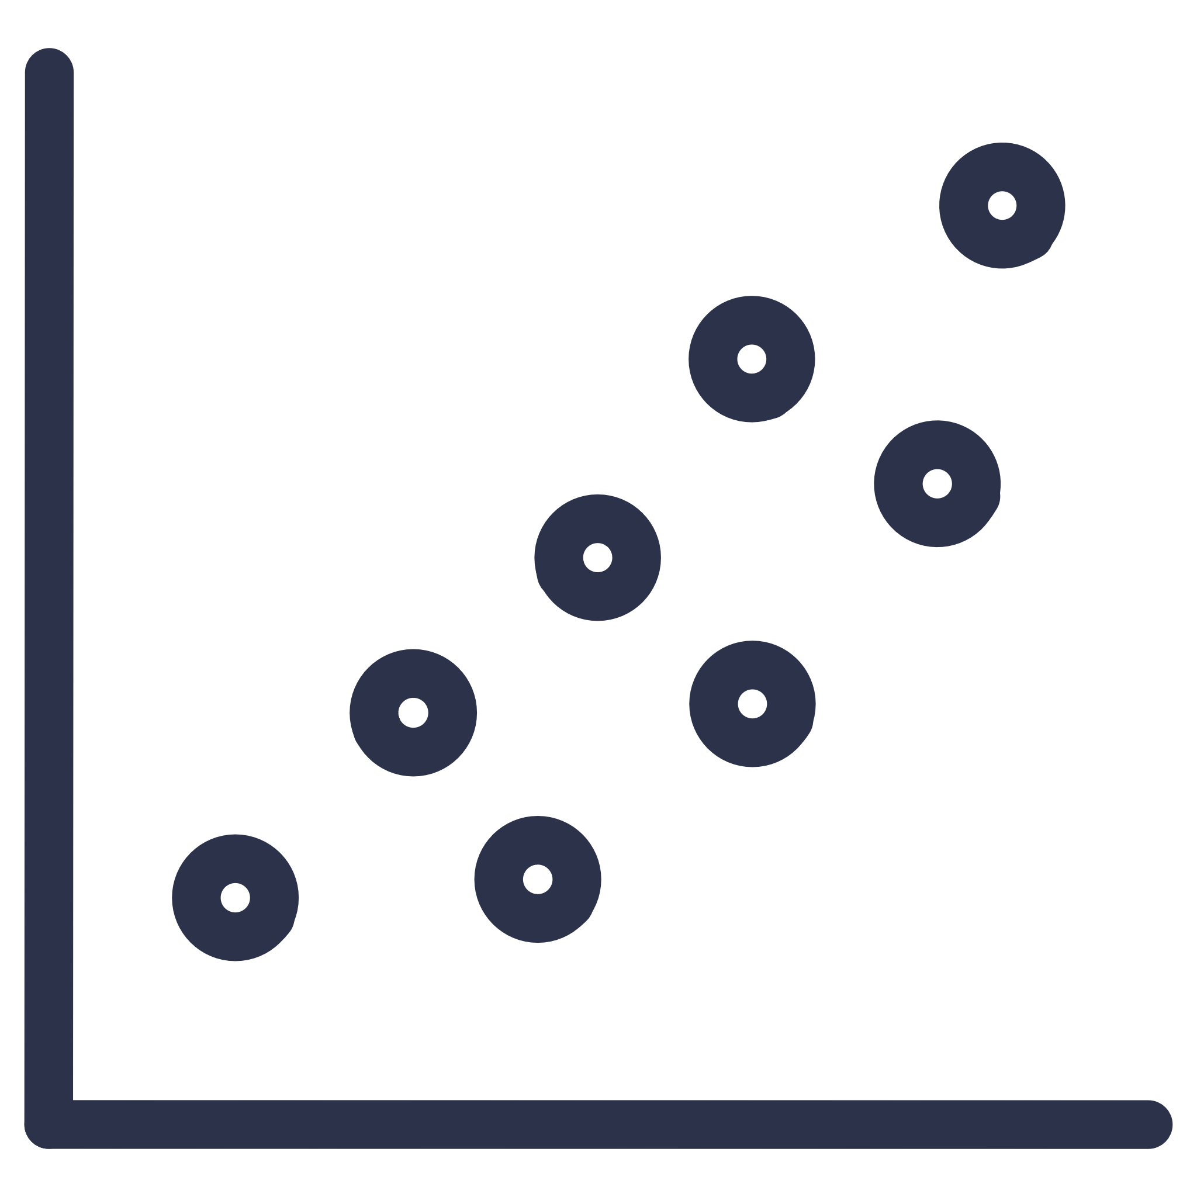

Does the data look real?
Univariate Analysis
Bivariate Analysis
What it checks: Do the individual columns (Age, BMI) look like the real data? The Metric: Mean Hellinger Distance Why: Measures the distance between probability distributions. A value close to 0 means perfect similarity.
What it checks: Do the correlations between variables (e.g., Weight vs. Height) stay the same? The Metric: Pairwise Correlation Difference (PCD) Why: Ensures we didn't break the biological rules connecting the variables(PCD~0).
Multivariate Analysis
What it checks: Can we distinguish the "fake" rows from the "real" rows? The Metric: Propensity Score MSE Why: We train a discriminator. If it can't tell real from fake (pMSE ~ 0), the synthetic data is excellent.

Slide 28
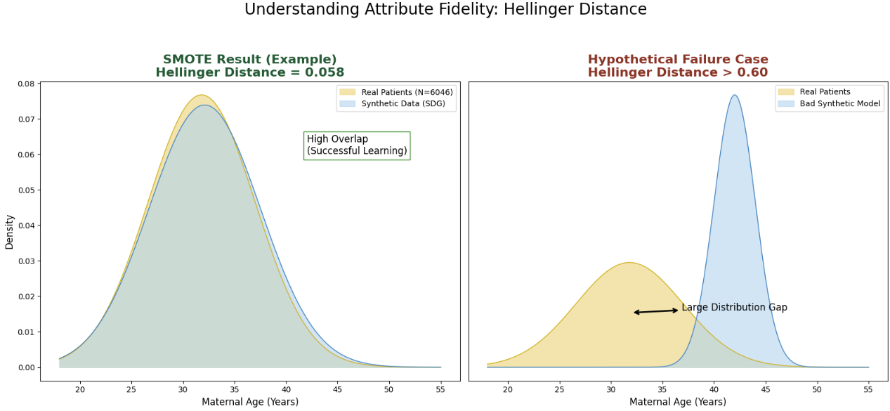
Hellinger Distance – Visually Explained

Slide 29
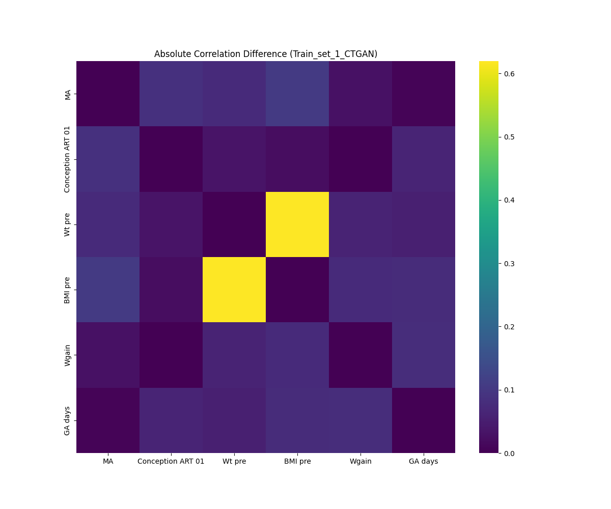
Pairwise Correlation Difference - Visually Explained
Ideally, in this example, this map
should be entirely dark purple
(zero difference). However, notice the
yellow blocks.
This indicates the synthetic model
struggled to capture the BMI and weight
relationship, which explains
why we need to be careful with
engineered features

Slide 30
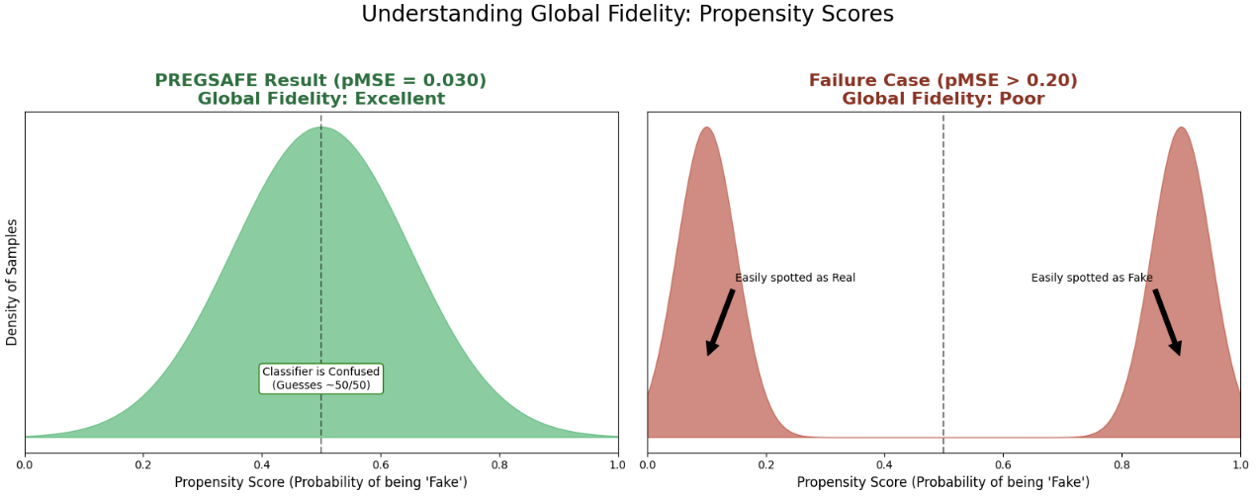
Propensity Score – Visually Explained

Slide 31
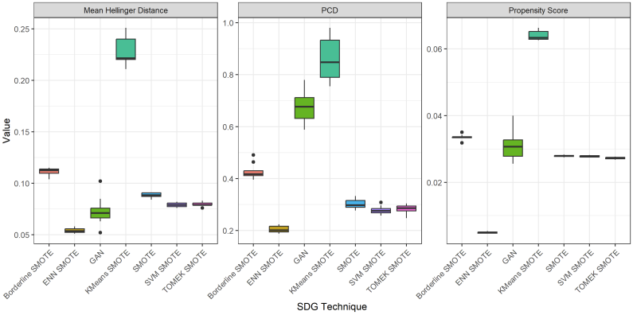
Which model fooled the statistics best?
Validation of ENN SMOTE:
ENN SMOTE is statistically
the "cleanest,“
It kept the Distributions correct
(Hellinger).
It kept the Correlations correct
(PCD).
It blended in well globally
(Propensity).
Distortion in Other Methods:
KMeans SMOTE (high green box)
and the GAN exhibit significantly
higher Propensity and PCD scores.
This implies these methods
introduced statistical artifacts
or distortions that make the
data easier to distinguish as "fake."

Slide 32
Does 'looking real' mean it works?
Aggregate Performance
Class-Specific Performance
Metric: Balanced Accuracy. What it checks: The arithmetic mean of Sensitivity and Specificity. It assesses overall performance while normalizing for class size. Why: In our imbalanced dataset, standard "Accuracy" is misleading Balanced Accuracy prevents this bias and gives a true picture of general performance.
Metric: Recall (Sensitivity). What it checks: The model's ability to correctly identify actual positive cases (GDM).Why: This is the critical metric for medical screening. A "False Negative" (telling a sick patient they are healthy) is dangerous. We prioritize high Recall to ensure no cases are missed. (good for minority class)

Slide 33
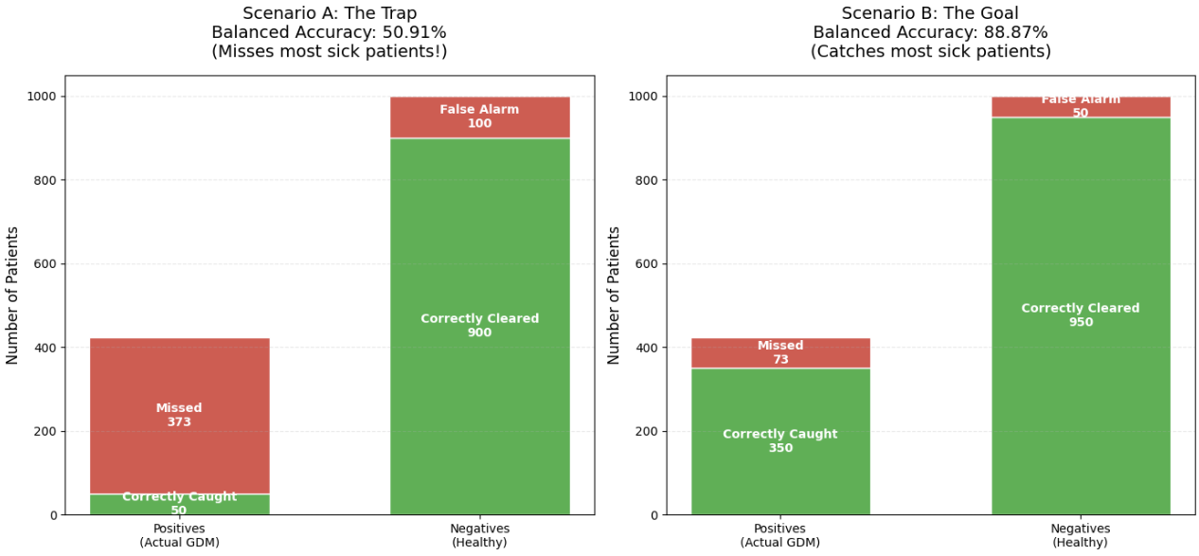
Balanced Accuracy – Visually Explained

Slide 34
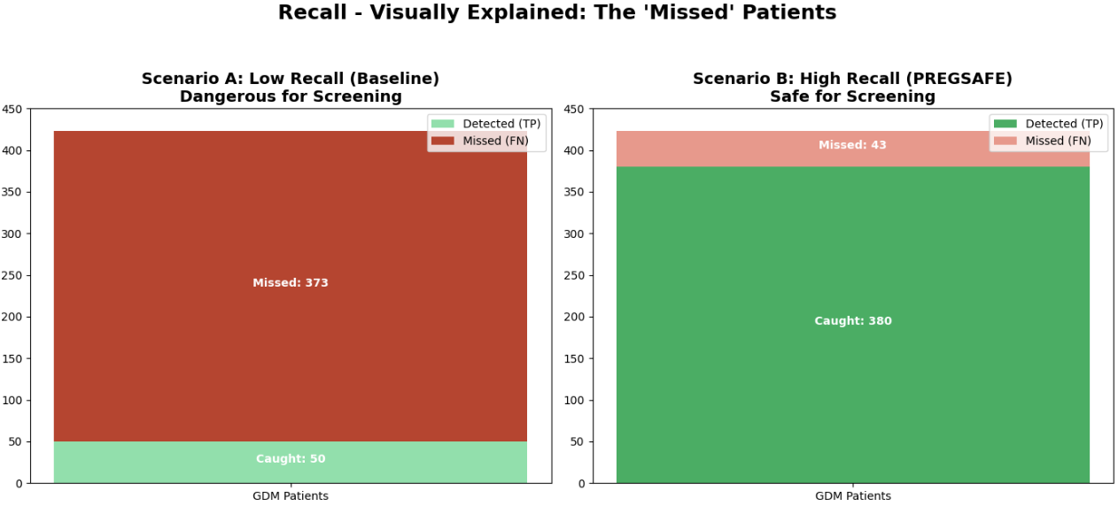
Recall (Sensitivity) – Visually Explained

Slide 35
Synthetic Data to the rescue!

Slide 36
PART 4: - PREGSAFE Webapp
Microservices, Cloud Deployment & Live Application

Slide 37
Microservice Architecture
Frontend UI
Orchestrator
Model Service
Hosted on Vercel (Edge)
Hosted on Render (Cloud)
Hosted on Render (Docker Container)
• Next.js (React) for type-safe interactions.
• Fast static loading via Global CDN. Parts are served based on your location
• Responsive & optimized for reliability.
• Python FastAPI middleware.
• Manages Auth, SQL DB, and Audit Trails.(SQLAlchemy → ORM, alembic → migrations)
• API key authentication and CORS protection offers security
• R Plumber API running in isolated Docker for smote variants
• SOLVES FRAGILITY: Encapsulates complex R dependencies.
• FAULT TOLERANT: Main app survives if models crash.
Hellinger Distance
Correlation Difference
Propensity Score

Slide 38
PART 5: - Conclusions
Key achievements

Slide 39




Did we meet our goals?
KPI 1.1: GDM prediction recall boosted by 15%
KPI 1.2: CTGAN successfully integrated
(Target ≥10%, COMPLETED)
from SECURED toolkit (COMPLETED)
KPI 2.2: 4 validation metrics used
KPI 3.2: 4 healthcare professionals' evaluation
(Hellinger distance, Pairwise correlation difference, Propensity Score, ML predictive performance) (COMPLETED)
(Qualitative evaluation, ONGOING) 4 healthcare professionals
specializing in maternal and fetal medicine

Slide 40
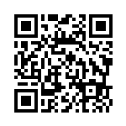
Thank you for your attention!
Scan me!
Contact Info:
Email: vas.tsavv@gmail.com
LinkedIn: https://www.linkedin.com/in/vasilistsavalias/
Github: https://github.com/vasilistsavalias

